Slide 1
INTERNSHIP STUDIO INTERNSHIP FOR ETHICAL HACKING TASK - 2

Slide 2
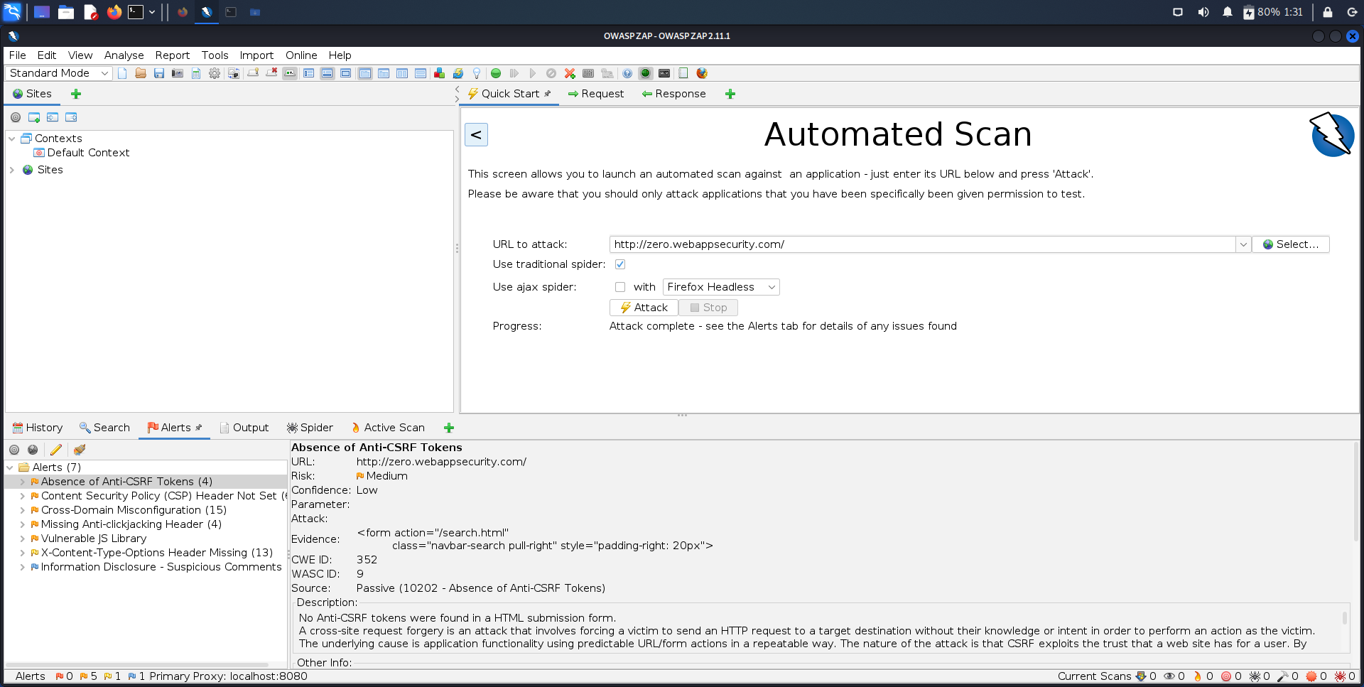
SCREENSHOT

Slide 3
REPORT:
**VULNERBILITY**
it has been detected that passwords that have been saved are sent over HTTP
rather than HTTPS
whereas HTTPS is a more secure method

Slide 4
THREAT :
since it is HTTP, all the user data that is the password are sent over
this protocol, since it in not a secure protocol
anyone can hack and penetrate the network and steal all the credentials,
which can be used to exploit the user and his data
and do malicious acts.

Slide 5
WHAT CAN BE DONE AS SECURITY MEASURES :
All the data (i.e., user credentials , username and passwords)
must all be served over an HTTPS network protocol,
it is a secure method of network and all data transferred
over this network is safe from any attacker or threats.

Slide 6
WHERE THIS THREAT WAS FOUND :
URL :http://zero.webappsecurity.com/login.html
Input Name :user_password
Form target action :http://zero.webappsecurity.com/signin.html
HOW IT WAS DETECTED :
It was detected by a well-known automatic vulnerability application
known as OWASP ZAP.

Slide 7
Report Generated By Application

